Slide 1
Inheritance

Slide 2
Inheritance
Inheritance in Java is a mechanism in object-oriented programming where a class (called the child class or subclass) derives the properties and behaviors of another class (called the parent class or superclass).
It allows the child class to reuse, modify, or enhance the functionality of the parent class, promoting code reusability.

Slide 3
extends Keyword in Java:
A subclass can inherit the properties and methods of a superclass by using the keyword extends. This allows the subclass to reuse and enhance the functionality of the superclass.
Syntax:
class Subclass extends Superclass {
// Additional variables and methods declarations
}
Key Points:
The subclass will have:
Its own variables and methods.
Access to the non-private variables and methods of the superclass (i.e., public and protected members).
Private Members: Private members of the superclass are not directly inherited by the subclass. However, they can be accessed indirectly through public or protected getter and setter methods defined in the superclass.

Slide 4
Types of Inheritance -
Java supports the following types of inheritance - 1- Single level inheritance 2- Multi level inheritance 3- Hierarchical inheritance 4- Multiple Inheritance (using interface) 5- Hybrid Inheritance

Slide 5
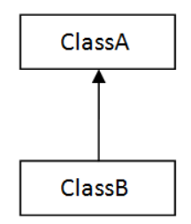
1. Single level inheritance -
In single level inheritance there is one subclass inheriting the properties of one super class. i.e. there is single level of inheritance.

Slide 6
Example 1 –
class Animal{
void eat(){System.out.println("eating...");}
}
class Dog extends Animal{
void bark(){System.out.println("barking...");}
}
class TestInheritance{
public static void main(String args[]){
Dog d=new Dog();
d.bark();
d.eat();
}}
Notes:
Output:
barking...
eating...

Slide 7
Example 2 –
class Marks
{
private int phy, chem;
public void inputM()
{
phy = Integer.parseInt(System.console().readLine("Enter physics marks"));
chem = Integer.parseInt(System.console().readLine("Enter chemistry marks"));
}
public void dispM()
{
System.out.println(phy+" "+chem);
}
public Marks()
{
System.out.println("Marks Default");
}
public Marks(int p)
{
phy = p;
}
public Marks(int p, int c)
{
phy = p;
chem = c;
}
}

Slide 8
class Student extends Marks
{
private int roll;
private String name;
public void inputS()
{
roll = Integer.parseInt(System.console().readLine("Enter roll"));
name = System.console().readLine();
super.inputM();
}
public void dispS()
{
System.out.println(roll+ " "+ name);
super.dispM();
}
public Student()
{
System.out.println("Student Default");
}
public Student(int r)
{
roll = r;
}
public Student(int r, String n)
{
roll = r;
name = n;
}
public Student(int r, String n, int p, int c)
{
super(p, c);
roll = r;
name = n;
}
}
public class Demo
{
public static void main(String[] args)
{
Student s1 = new Student();
}
}
Notes:
Output -
Marks Default
Student Default

Slide 9
Program Desciption -
Program defines a super class named Marks that is inheriting by sub class named Student. So Student class, in addition to its own variables and methods, also has Marks class variables and methods (which are not private, as we already know private members cannot be inherited). In fact in our example Student class will not have any variable of Marks class because all variables of Marks class are private. Only methods of Marks class will be available there. Note the use of super keyword within methods of Student class.

Slide 10
super keyword -
super is used to call the super class methods and constructors within subclass.
Always remember that constructors do not inherit. We can only call them in sub class constructors using super keyword. You should remember the following points while calling parent class constructor -
1- super() should be the first statement within constructor. Where as within methods this is not the compulsion, super can be anywhere.
2- super() should match the order and type of variables passed in the constructor that we want to call. Now consider output of the program. When the statement
Student s1 = new Student();
gets executed , we already know it is going to call default constructor of Student class. And always remember that if we have not defined any super() within any constructor in case of subclass, then there will be a hidden super() that make call to parent class default constructor. i.e.

Slide 11
public Student()
{
super(); // this statement will be hidden
System.out.println("Student Default");
}
When super() will get executed, compiler will look for a constructor that is not having any parameters (i.e. default constructor) and that constructor gets executed first and print 'Marks Default' on output screen, then it comes back and print 'Student Default'.
Now consider the second variation of above program, we are going to change only main class (Demo) as follows -
public class Demo
{
public static void main(String[] args)
{
Student s1 = new Student(1, "John", 80, 90);
s1.dispS();
}
}
Notes:
Output -
1 John
80 90

Slide 12
In this case when the statement
Student s1 = new Student(1, "John", 80, 90);
gets executed, compiler will look for a constructor in Student class that is having 4 parameters, first one of integer type, second one of String type, third and fourth are of integer types. It finds it there and executes it.
The first statement in constructor is super(p, c); it causes the compiler to look for a constructor in super class (Marks) for a constructor that is having two int type parameters and execute that constructor. This constructor will set the value of phy and chem variables at 80 and 90. Then it comes back to Student constructor and set the values of roll and name to 1 and John respectively.
The statement s1.disp(); gets executed and causes the dispS() method of Student class to call. This will first print the value of roll and name and then call dispM() method of Marks class and that will print the value of phy and chem.

Slide 13
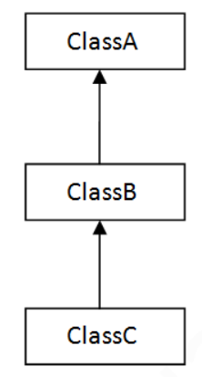
Multilevel Inheritance
Multilevel inheritance involve more than two classes. In multilevel inheritance a sub class will be inheriting the properties of its super class and that super class will be inheriting the properties of its super class and so on.

Slide 14
Example -
In the below example class A will be Marks class, class B will be Student class and class C will be Comment class.
class Marks
{
private int phy, chem;
public void inputM()
{
phy = Integer.parseInt(System.console().readLine("Enter physics marks"));
chem = Integer.parseInt(System.console().readLine("Enter chemistry marks"));
}
public void dispM()
{
System.out.println(phy+" "+chem);
}
public Marks()
{
System.out.println("Marks Default");
}
public Marks(int p)
{
phy = p;
}
public Marks(int p, int c)
{
phy = p;
chem = c;
}
}

Slide 15
class Student extends Marks
{
private int roll;
private String name;
public void inputS()
{
roll = Integer.parseInt(System.console().readLine("Enter roll"));
name = System.console().readLine();
super.inputM();
}
public void dispS()
{
System.out.println(roll+ " "+ name);
super.dispM();
}
public Student()
{
System.out.println("Student Default");
}
public Student(int r)
{
roll = r;
}
public Student(int r, String n)
{
roll = r;
name = n;
}
public Student(int r, String n, int p, int c)
{
super(p, c);
roll = r;
name = n;
}
}

Slide 16
class Comment extends Student
{
String comment;
public void inputC()
{
super.inputS();
comment = System.console().readLine("Enter Comments");
}
public void dispC()
{
super.dispS();
System.out.println(comment);
}
public Comment()
{
System.out.println("Comment Default");
}
public Comment(int r, String n, int p, int c, String com)
{
super(r, n, p, c);
comment = com;
}
}

Slide 17
public class Demo
{
public static void main(String[] args)
{
Comment c1 = new Comment(1, "John", 80, 90, "Good");
c1.dispC();
}
}
Notes:
Output
1 John
80 90
Good

Slide 18
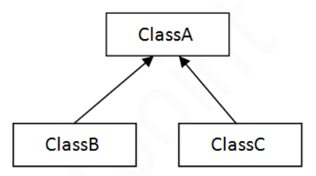
Hierarchical Inheritance -
In hierarchical inheritance there is single parent class that is inheriting by multiple subclasses. It is somewhat similar to tree based structure.

Slide 19
Example -
In the below example class A will be Marks class, class B will be Student class and class C will be Comment class.
class Marks
{
private int phy, chem;
public void inputM()
{
phy = Integer.parseInt(System.console().readLine("Enter physics marks"));
chem = Integer.parseInt(System.console().readLine("Enter chemistry marks"));
}
public void dispM()
{
System.out.println(phy+" "+chem);
}
public Marks()
{
System.out.println("Marks Default");
}
public Marks(int p)
{
phy = p;
}
public Marks(int p, int c)
{
phy = p;
chem = c;
}
}

Slide 20
class Student extends Marks
{
private int roll;
private String name;
public void inputS()
{
roll = Integer.parseInt(System.console().readLine("Enter roll"));
name = System.console().readLine();
super.inputM();
}
public void dispS()
{
System.out.println(roll+ " "+ name);
super.dispM();
}
public Student()
{
System.out.println("Student Default");
}
public Student(int r)
{
roll = r;
}
public Student(int r, String n)
{
roll = r;
name = n;
}
public Student(int r, String n, int p, int c)
{
super(p, c);
roll = r;
name = n;
}
}

Slide 21
class Comment extends Marks
{
String comment;
public void inputC()
{
super.inputM(); // Here we can not call Student class Methods
comment = System.console().readLine("Enter Comments");
}
public void dispC()
{
super.dispM();
System.out.println(comment);
}
public Comment()
{
System.out.println("Comment Default");
}
public Comment(int p, int c, String com)
{
super(p, c);
comment = com;
}
}
public class Demo
{
public static void main(String[] args)
{
Student s1 = new Student(1, "John", 80, 90);
s1.dispS();
Comment c1 = new Comment(100, 70, "Good");
c1.dispC();
}
}
Notes:
Output -
1 John
80 90
100 70
Good

Slide 22
Here both Student and Comment classes are inheriting Marks class. So in Comment class we cannot call Student class constructor or methods using super because there is no relation between them. That?s why we make changes in Comment class constructors and methods.

Slide 23
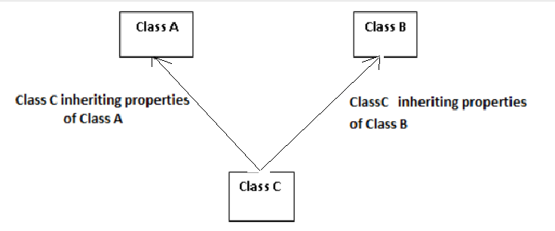
Multiple and Hybrid Inheritance -
Multiple inheritance is just reverse of Hierarchical inheritance. That is, there is one sub class inheriting the properties of multiple super classes.

Slide 24
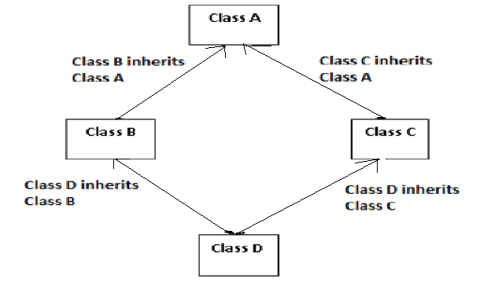
Hybrid inheritance is a combination of two or more inheritance, for example combination of hierarchical inheritance and multiple inheritance.
Multiple and Hybrid inheritance are not supported by java classes. Java supports them using the concept of interface.

Slide 25
Why Multiple Inheritance is Not Supported in Java (Using Classes):
Java does not support multiple inheritance with classes to avoid ambiguity and maintain simplicity in the inheritance hierarchy. The key issue arises when two parent classes have methods with the same name and a child class inherits from both.

Slide 26
Example –
class Parent1 {
void display() {
System.out.println("Display from Parent1");
}
}
class Parent2 {
void display() {
System.out.println("Display from Parent2");
}
}
// Attempting multiple inheritance (not allowed in Java)
class Child extends Parent1, Parent2 { // Error: Java does not allow this
// Ambiguity: Which 'display()' method to inherit?
}
public class Main {
public static void main(String[] args) {
// Cannot compile
}
}

Slide 27
Reason for Restriction:
If Child were to inherit from both Parent1 and Parent2, the compiler would not know which version of the display() method to call. This ambiguity is known as the diamond problem.
How Java Resolves This:
Java avoids this problem by:
Restricting Multiple Inheritance with Classes: A class can only inherit from one superclass.
Using Interfaces: Multiple inheritance is achieved through interfaces, as they do not contain implementation, only method signatures.

Slide 28
Method Overriding (Function Overriding )-
Method overriding is a feature in Java that allows a subclass to provide a specific implementation for a method that is already defined in its superclass. It is a key concept in achieving runtime polymorphism.
In method overriding, the method in the subclass should have the same name, return type, and parameter list as the method in the superclass.
Key Points:
Same method signature: The method in the subclass should have the same name, return type, and parameter list as the method in the superclass.
@Override Annotation: It is recommended (but optional) to use the @Override annotation to indicate that a method is overriding a method in the superclass.
Dynamic Method Dispatch: At runtime, the JVM decides which version of the method to call (superclass or subclass), which is what enables polymorphism.

Slide 29
Example –
class Superclass {
void display() {
System.out.println("Display method in Superclass");
}
}
class Subclass extends Superclass {
@Override
void display() {
System.out.println("Display method in Subclass");
}
}
public class Main {
public static void main(String[] args) {
Superclass obj = new Subclass();
obj.display(); // Calls the overridden method in Subclass
}
}
Notes:
Output-
Display method in Subclass

Slide 30
Why Use Method Overriding?
Polymorphism: It allows the same method name to have different implementations depending on the object type.
Runtime Flexibility: The subclass can change or extend the behavior of the superclass without modifying the superclass's code.

Slide 31
Example 2 –
class Animal {
void sound() {
System.out.println("Animal makes a sound");
}
}
class Dog extends Animal {
@Override
void sound() {
System.out.println("Dog barks");
}
}
class Cat extends Animal {
@Override
void sound() {
System.out.println("Cat meows");
}
}
public class Main {
public static void main(String[] args) {
Animal myAnimal = new Animal();
Animal myDog = new Dog();
Animal myCat = new Cat();
myAnimal.sound(); // Calls Animal's sound()
myDog.sound(); // Calls Dog's sound()
myCat.sound(); // Calls Cat's sound()
}
}
Notes:
Output –
Animal makes a sound
Dog barks
Cat meows
In this example, both Dog and Cat classes override the sound() method of the Animal class.The method sound() is called on different objects (myAnimal, myDog, myCat), and the version of the method that corresponds to the actual object type is called, not the reference type (demonstrating runtime polymorphism).

Slide 32
Covariant Return Type –
Covariant return type is a feature in Java where a subclass method can return a type that is a subclass of the type returned by the superclass method. This allows the return type to be more specific in the subclass method while maintaining the general return type in the superclass method.
This is useful for returning more specific objects or collections in the subclass while still adhering to the method signature from the superclass.

Slide 33
Example –
class Animal {
// Method in the superclass with return type Animal
Animal makeSound() {
System.out.println("Animal makes a sound");
return new Animal();
}
}
class Dog extends Animal {
// Overriding method in the subclass with a more specific return type (Dog)
@Override
Dog makeSound() {
System.out.println("Dog barks");
return new Dog(); // Returning a more specific type (Dog)
}
}
public class Main {
public static void main(String[] args) {
Animal myAnimal = new Animal();
Animal myDog = new Dog();
myAnimal = myAnimal.makeSound(); // Calls Animal's makeSound()
myDog = myDog.makeSound(); // Calls Dog's makeSound()
}
}

